Slide 1
Strategic Retreat
Library
Dr. Abdulla Alhefeiti March 21, 2022

Slide 2
Reflections of 2021
Areas | Achievements
Collection | over 650,000 eBooks, 23,000 e-journals, 122,456,243 abstracts and over 100,000 print books, and other online resource are available to fulfill the academic department’s needs. Successfully handed over ARZ library and relocating the collections as per the academic programs across two campuses.
Open access Publications | Achieved the target by including more databases in the open-access platform and providing the KU authors with the needed training. There was an increase of 87.5% in published OA articles in publishers that are included in the project that the library oversees. Overall published 104 papers on the top Journals
Library System - (ILS) | finalized phase one of the library system project, selected Alma system, and signed the supplier's agreement. Currently in the implementation process. The project is due to be completed in June 2022, as planned.
information & data literacy | Able to conduct 127 Virtual training and seminars to support distance learning during the pandemic. Including information literacy classes, workshops, one-to-one group sessions.
Effective communication and partnership with faculty, students and researches | more than 1500 requests through the interlibrary loan- documents delivery services.

Slide 3
Breaking Departmental Silos
Library
Blackboard – EDS integration
Intergrade the Alma system with the registrar office system
Provide the alumni with the library privilege
Koha Support to the CTL and student success
Student Thesis – Alkazna repository

Slide 4
Commitments of 2022
Objectives | KPIs
Strengthen the library collection and information resources in various formats | Increase the number of digital collections of online and print books, reference materials, as well as electronic resources. The new target as follow: E-journal 61,000, EBook 690,000, databases 80. Ensure collections budget is fully utilized at a rate of at least 100% of the budget expenditures.
Information & data literacy to support learning and lifelong information skills all students | Continue to support information & data literacy by interacting with program coordinators of Preparatory, Undergraduate, and Graduate programs. The new target is 130.
Implement an integrated library system (ILS) | finalize the implementation process and deliver the project. 100 %
Maintain effective communication and partnership with faculty and students. | Continue to support the KU community by fulfilling requests ILL, answering queries, and supporting research‐specific requirements. The new target is 1600.
Provide effective services and resources that foster learning and research in the College of Medicine and Health Sciences | continue to expand efforts to connect with medical school and provide more resources and services. Expand the medical collection by 15 % to support the faculty and student research.
Extend the gold open access services to promote and support publishing in the Open Access journals | Continue to expand the open access services, training, and Open Access publishing for KU researchers. The new target is 130 Publications in Top Journals.

Slide 5
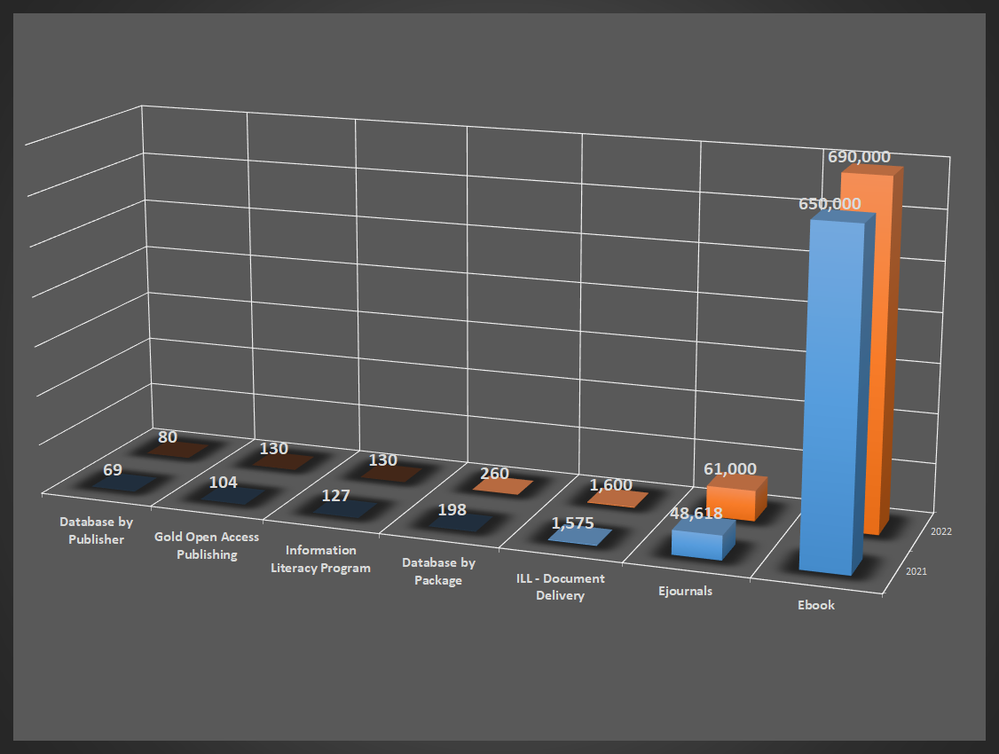
Library KPI’S figures- Academic Year 2021-2022

Slide 6

Strategic Priorities and Initiatives
Priorities | Initiatives
1. Ranking: Top 100 | a) PHD students: increase quality and quality
 | b) Publications in Top Journals: Gold Open Access Publishing Library
 | c) Reputation: alumni employers, student exchange, international internships, international competitions and conferences
2. Graduate Employment: Target 90% | a) Holistic Career Guidance
 | b) Experiential Learning: internships, student exchange, undergraduate research experience, field trips, community service, student teaching, part-time jobs, clinical education Library
 | c) Skills for Jobs of the Future: information & data literacy, technological agility, self-management, self-assessment, lifelong Learning, communication, collaboration, intercultural effectiveness *
3. Increase & Diversify University Revenue | a) University Fees: Self-paying and externally sponsored students
 | b) Continuing Education: Coursera courses, training for High School Teachers Library
 | c) Industry-funded Outreach programs
4. Process Efficiency & Customer Satisfaction | a) Enhance cross-departmental workflows Library
 | b) Utilize Data to make Informed Decisions
 | c) Analyze Survey results and continuous improvement

Slide 7
Any Questions

